Slide 1
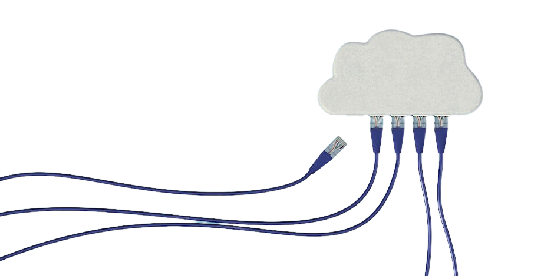
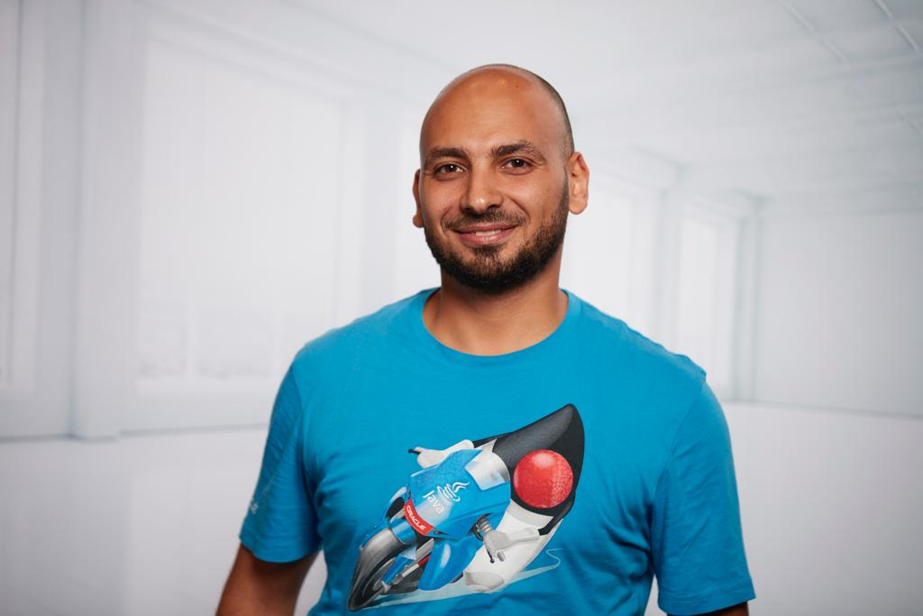


A Deep-Dive journey in Developing Microservices with Java, Spring Boot/ Cloud, Docker, Kubernetes
CLOUD DAY 2023
Ahmad Gohar
Senior Solution Architect@ IBM

Slide 2







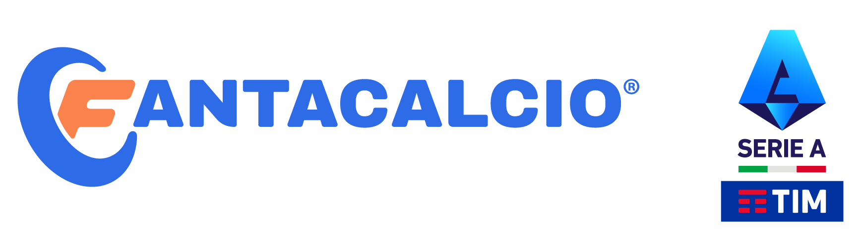


KUDOS

Slide 3
Our Journy Today !
Business Case
Microservice Architecture
Microservice Design
Service Discovery
Confirguration Server
Spring Projects
Spring Boot
Spring Cloud
Spring Data
Containerization
Docker
Kubernetes

Slide 5
GRAZIE!
CLOUD DAY 2023

